Slide 3
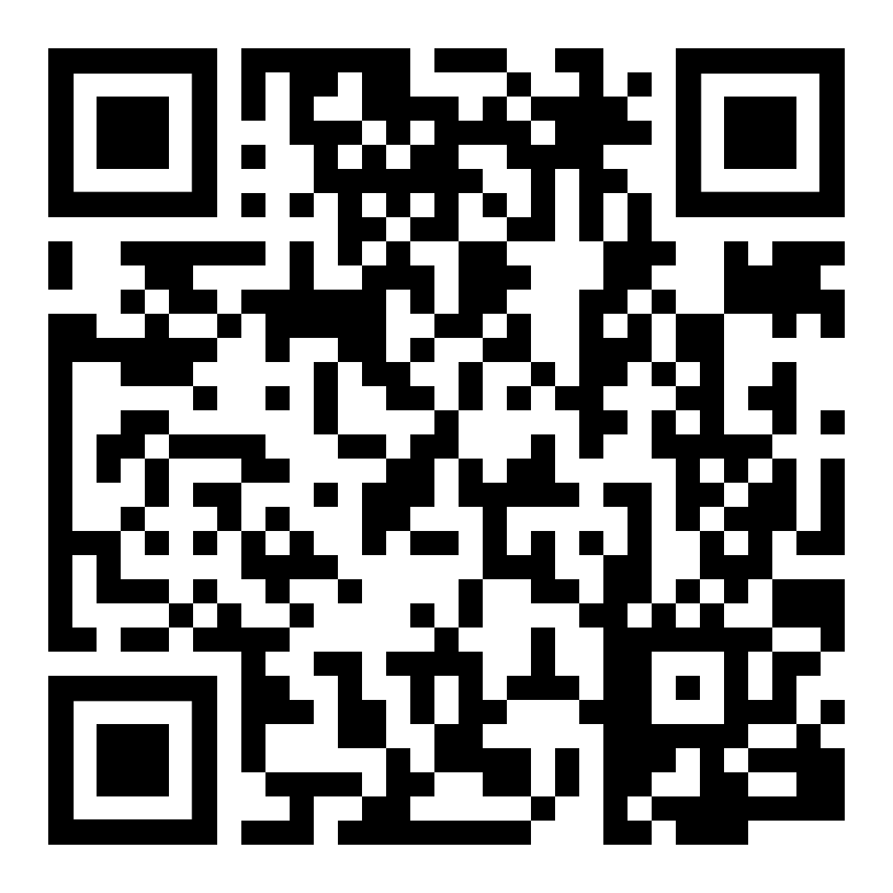
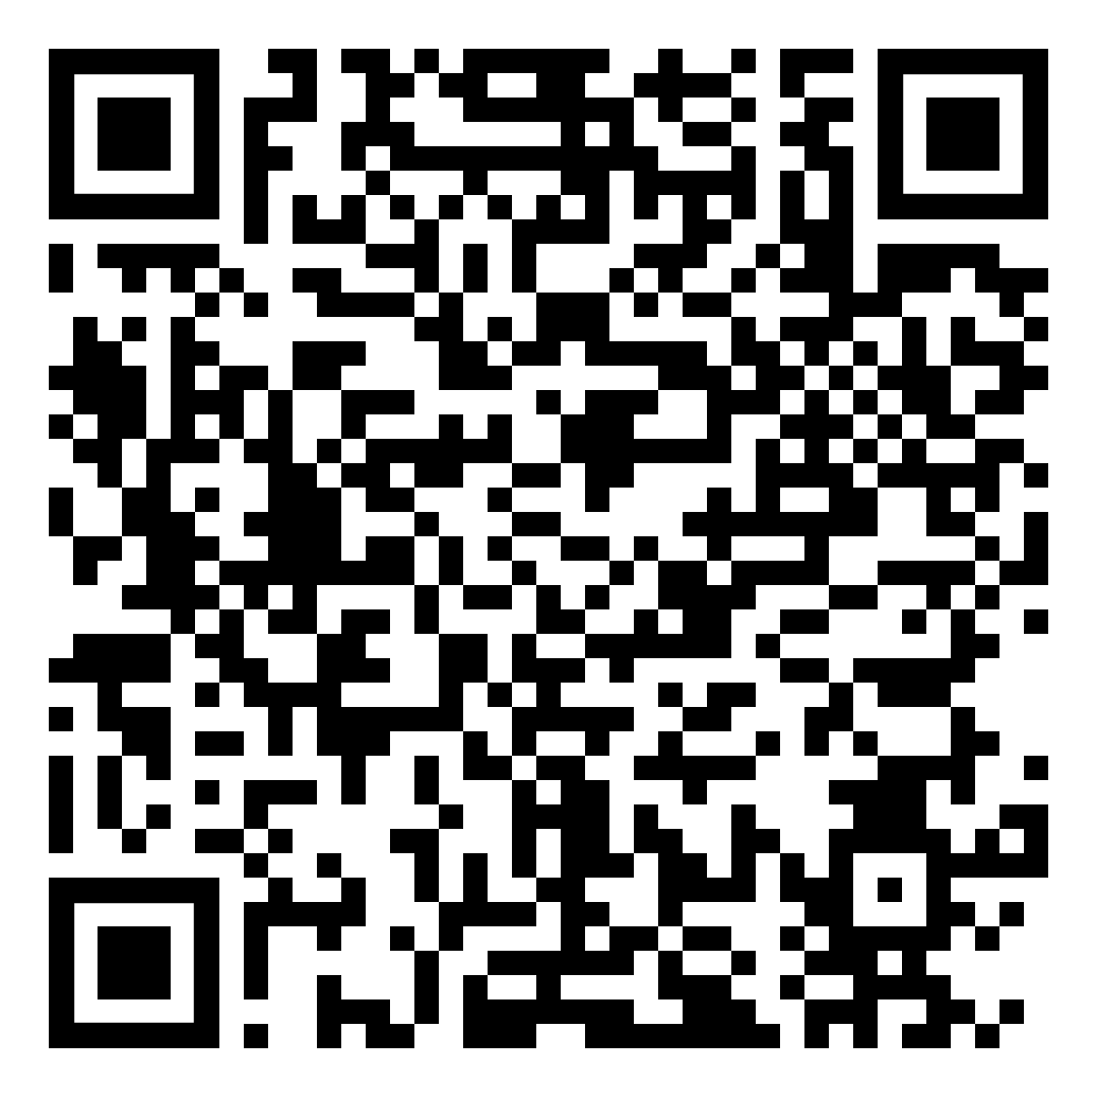
Create an online account at www.linqconnect.com
or scan the QR codes below to download the mobile app.
Apple QR Code for LINQ Connect App
Google QR Code for LINQ Connect App

Slide 4
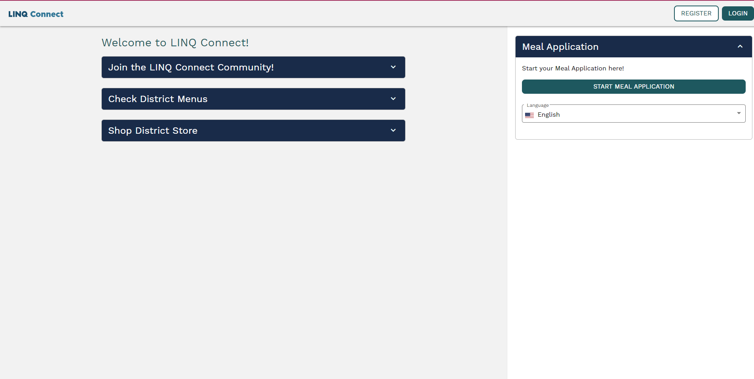
If you have not created a LINQ Connect account, click on “Register” to create an account. If you have already created an account, click on “Login”.
Click on any of these drop-down boxes to get more information.
Click on the drop-down box to choose preferred language.

Slide 5
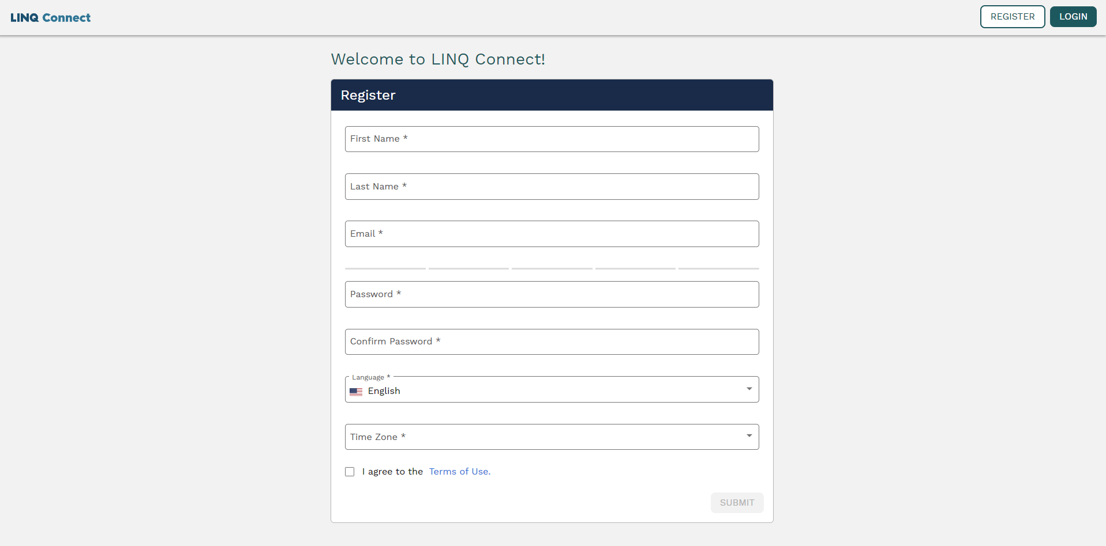
Please select your preferred language by clicking on the drop-down box.
Please select “Eastern Time” (US and Canada)” from the drop-down box.
Click here if you agree to the Terms of Use.
Please click here to proceed to the next page.

Slide 7
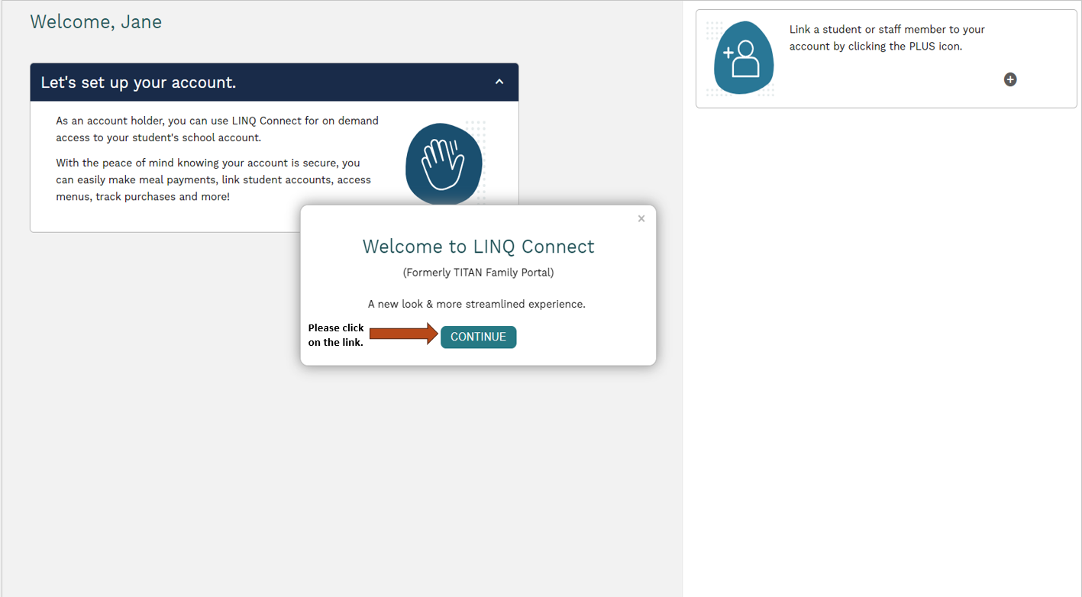

Slide 8
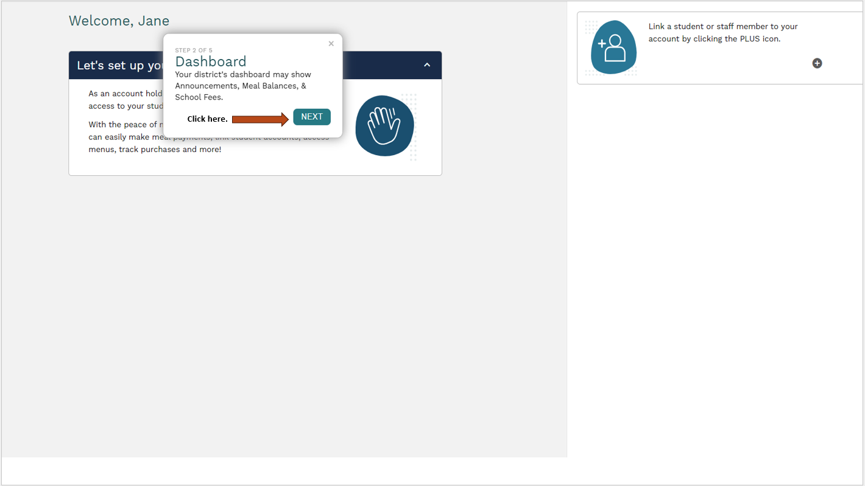

Slide 9
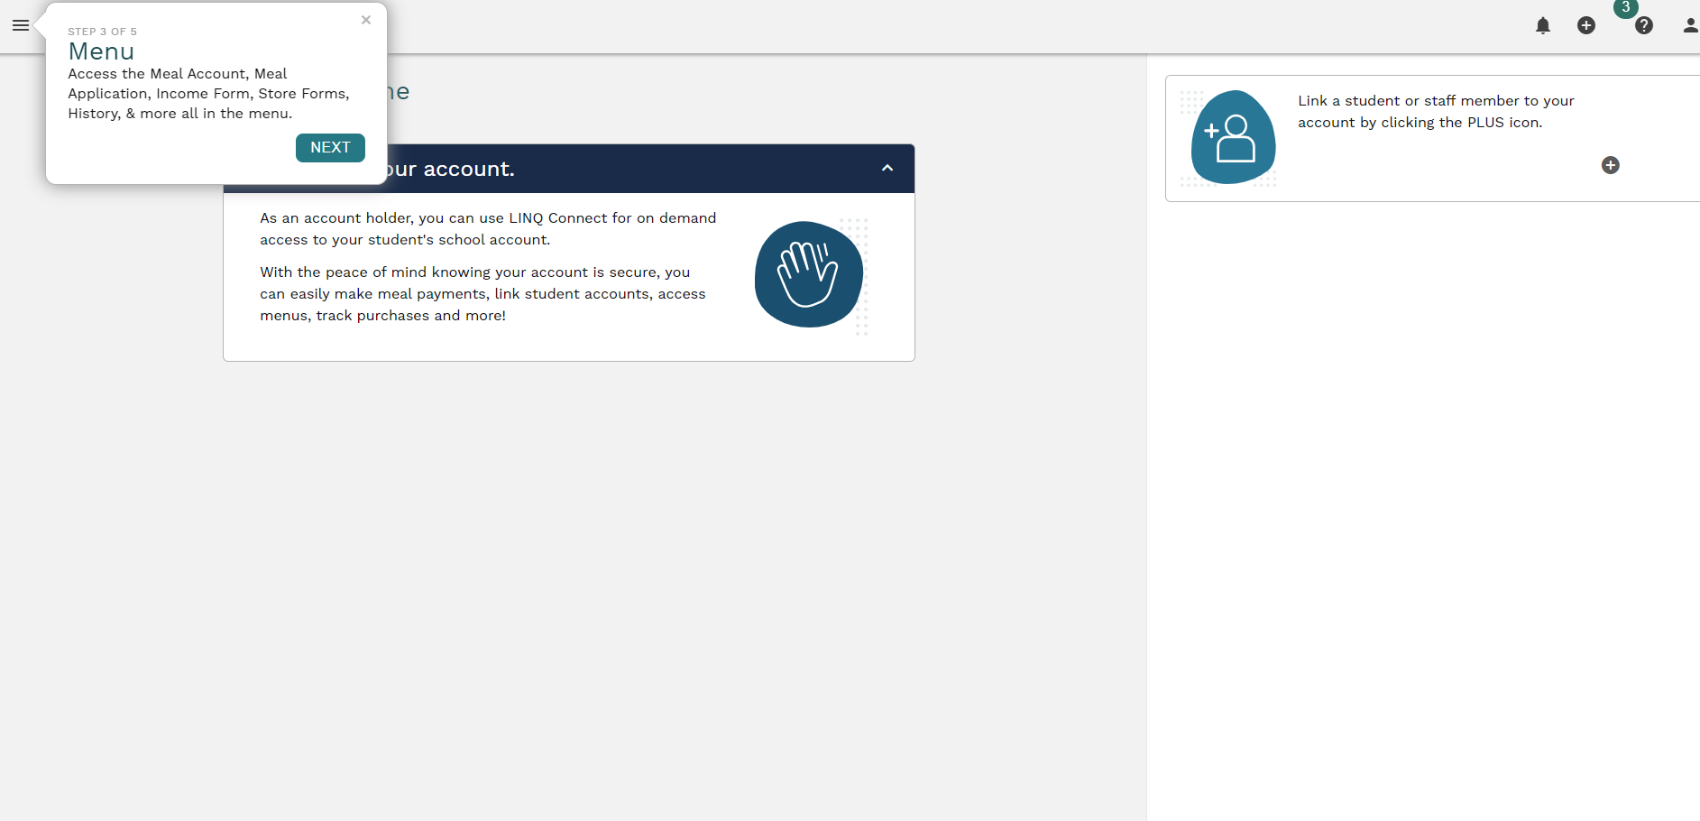
Click here.
This plus sign indicates that you can include more students or staff residing in your household.

Slide 10
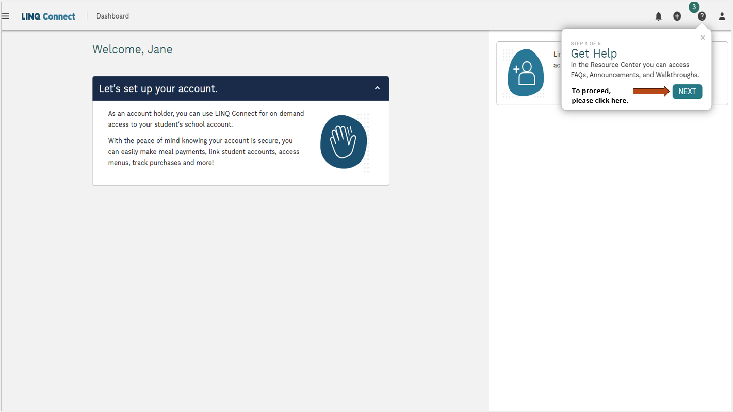

Slide 11
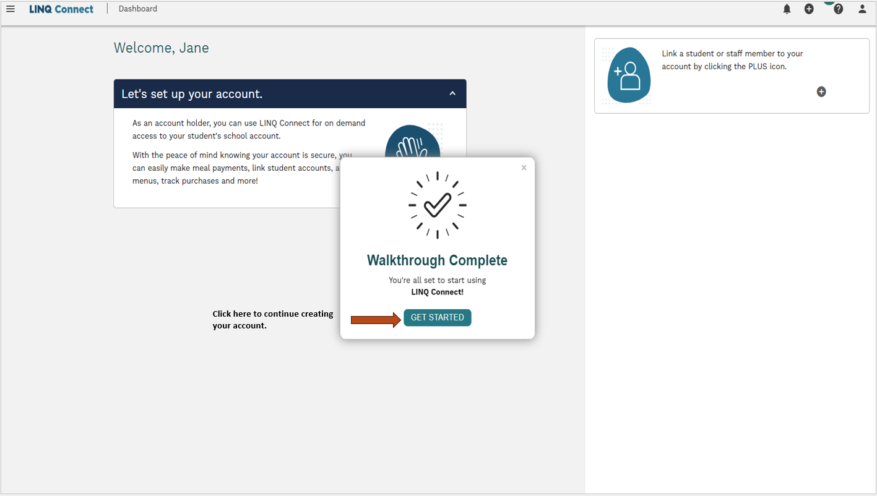

Slide 12
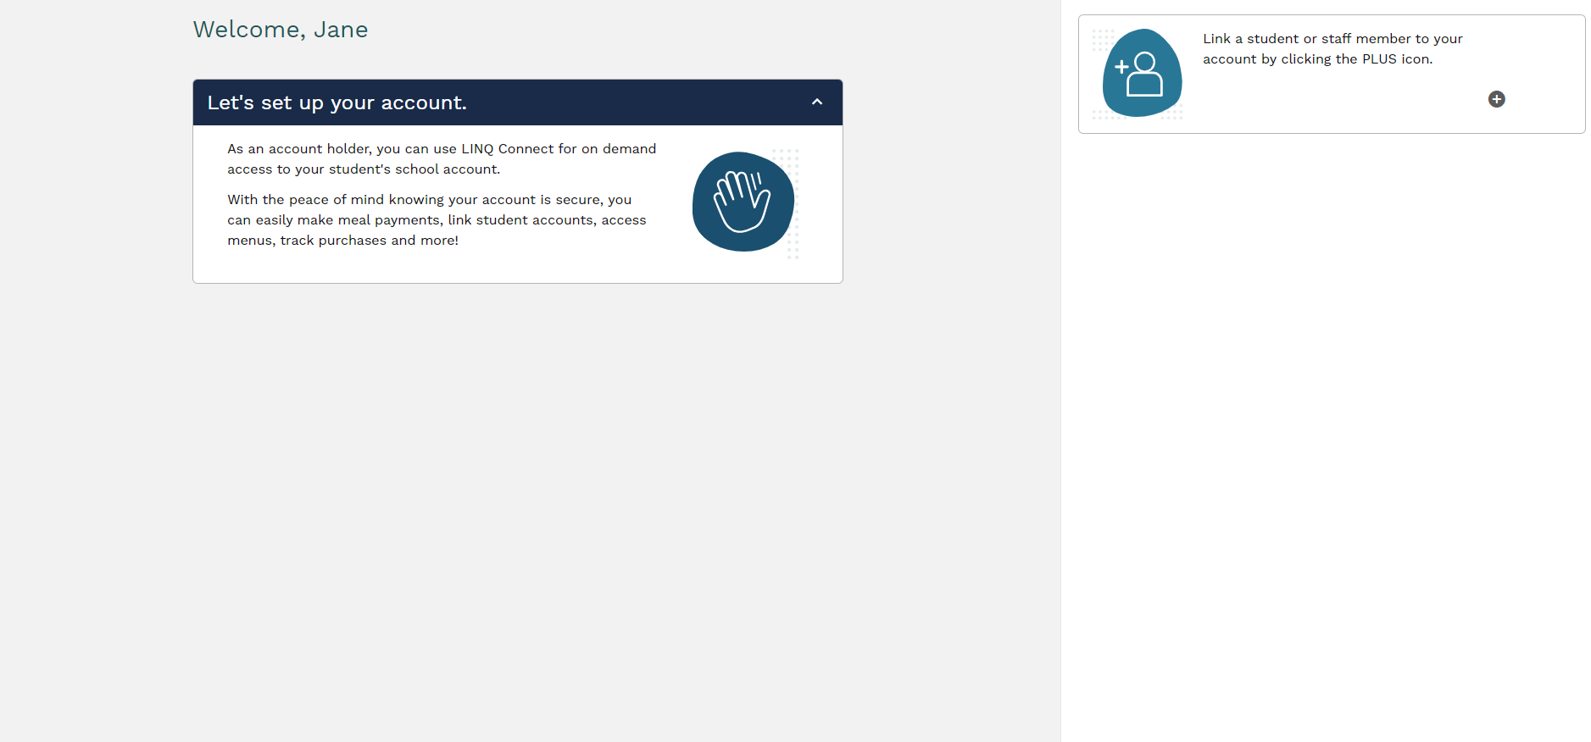
To connect students to your LINQ, Connect Account click here.

Slide 13
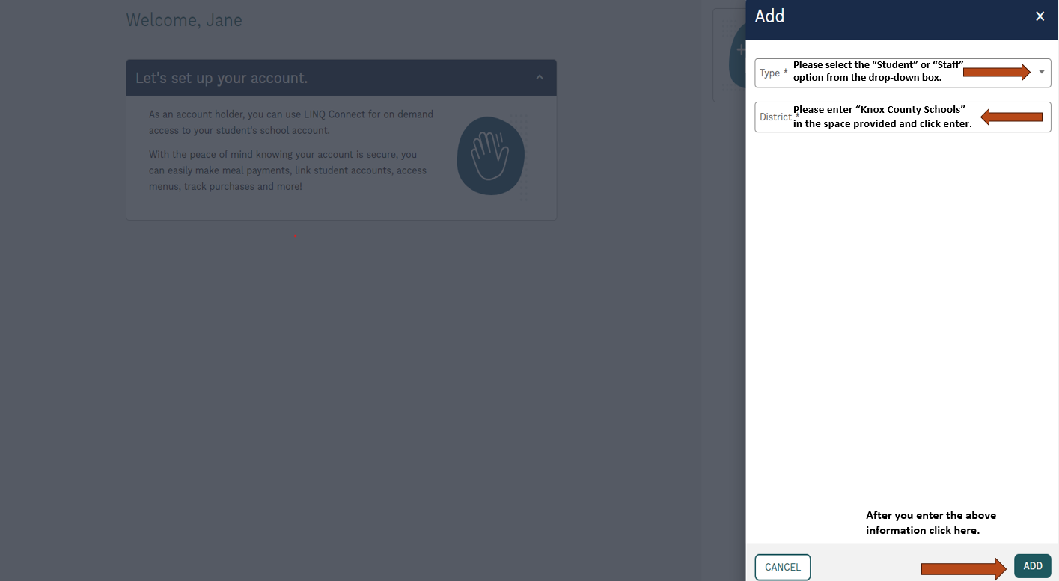

Slide 14
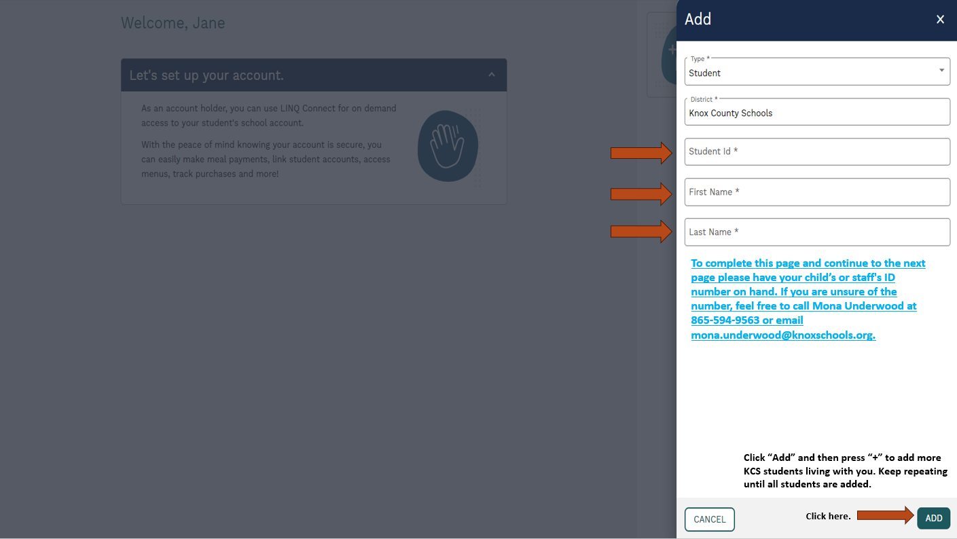

Slide 15
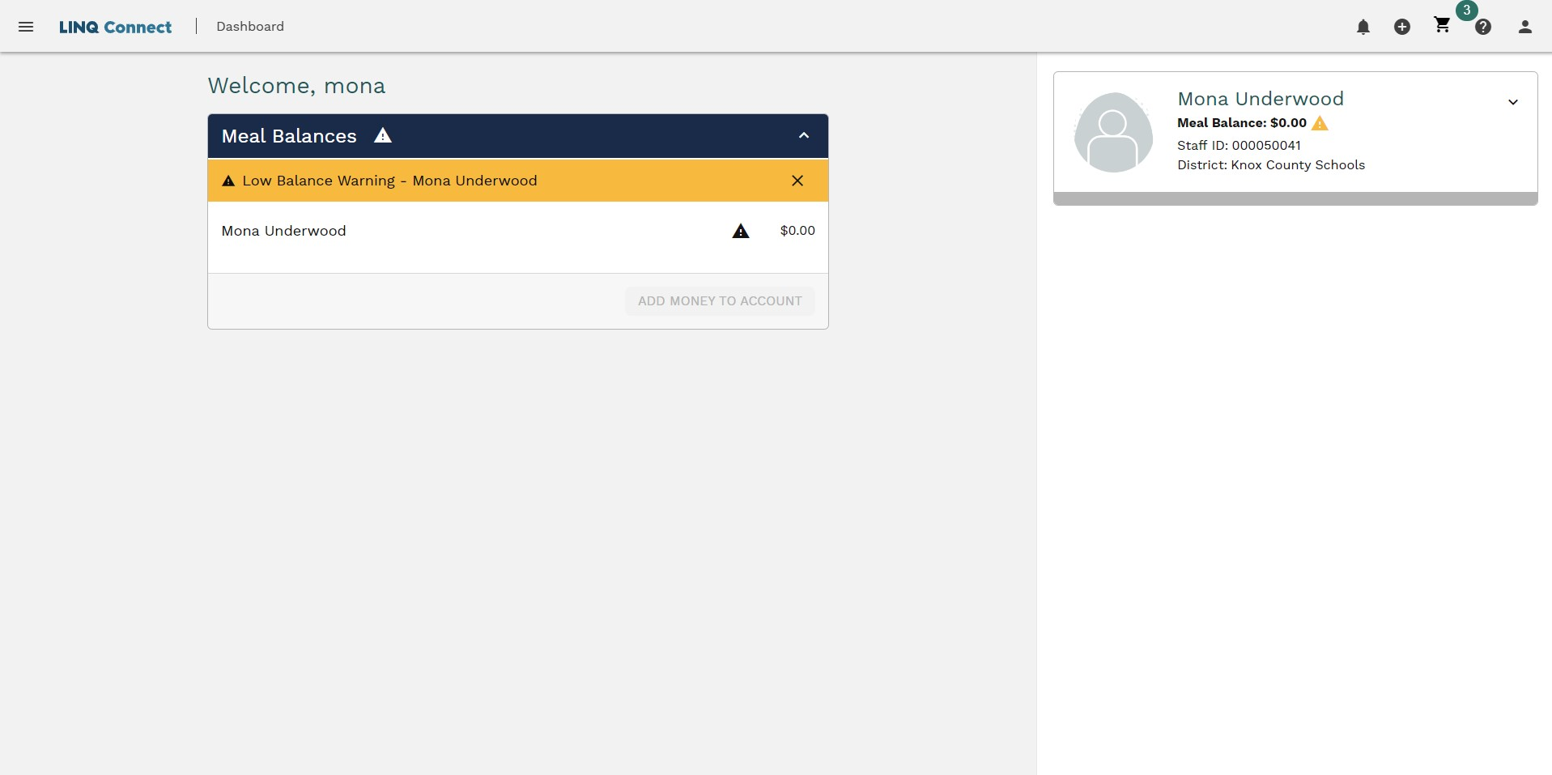
LINQ Connect Dashboard
*NOTE* We recommend you watch the PowerPoint on “Applying for Free & Reduced School Meals on LINQ Connect” Knox County Schools.

